Slide 1

MES3: Research Design and Quantitative Methods
Managing, Manipulating, and Curating Data (Part I)
Judy Cushing
Week 8, Spring 2012
Part I (Tuesday) Recap Suzanne’s Lecture (Week 5) – Curating YOUR DATA? Just what are you learning this quarter? (Concepts, Skills, Abilities) Data Transformations Why look at R (in addition to Excel, JMP, Resampling Stats, PC Ord)? A quick look at R…. Part II (Thursday) More on New Technologies

Slide 2
Recap Suzanne’s Lecture….
What data curation tasks make sense for you this quarter?
What of that does your future hold?
Adopt a common sense approach for this quarter…
Simple metadata, simple data tables in Excel
For the future? It’s a new world….
Recall Deb Peterson’s words…. How is this world changing for you? What do you need to know (how to do)? How could you give yourself an edge in the job market?

Slide 3
What are you learning this quarter?
Concepts….
Skills….
Abilities….

Slide 4
What are you learning this quarter?
Concepts
  What’s a normal distribution?
  What does “statistically significant” mean?
  p-value
  Parametric statistics
  t-test
  ….
Skills….
Abilities….

Slide 5
What are you learning this quarter?
Concepts….
Skills
  How to use Excel
  How to use JMP
  How to use Resampling Add in for Excel
  PC-ORD
  R
Abilities….

Slide 6
What are you learning this quarter?
Concepts….
Skills ….
Abilities….
  Research design….
  How to recognize what kind of data you have
  Which statistical test to use
  How to manipulate your data
  How to learn a new statistical package, or how to do a new test in a package you know….

Slide 7
How do you learn a new statistical package, or a new test in a package you know….?
Do the tutorials (e.g., in JMP!)
Use the help functions (e.g., in Excel)
Talk to others….
Learn another package and see how what you know transfers….

Slide 8
Why look at R?
It’s free….
Its functions are transparent….
It’s extensible….
It’s becoming a “standard” of sorts….
It’s fun…. Well, sort of….

Slide 9
Recap Suzanne’s Talk
Database and Metadata overview
  General introduction to information management
  Metadata (data descriptions)
  Spatial data
  Forest Science Data Bank (FSDB)
Web demos
  General (research; personnel; data)
  Network Resources
  Online metadata (example metadata, EML, PDF; data download)
Preparing and Submitting metadata/data
  Web interface
  Word document
  Present spreadsheet file
Data examples
  SB - lichen dataset
  CP - soil respiration due to ectomycorrhizal mats dataset

Slide 10
Ecoinformatics Challenges
Ecologists use heterogeneous data from many sources for synthesis
  Manually-collected data, instrument data loggers, spatial data, streaming data, web/network data stores
  New tools and technologies required for data integration
Expectations for data accessibility increasing
Data volumes increasing exponentially – WHY?
Requirements for data documentation (metadata) quality and completeness increasing -- WHY?
Notes:
Data processing, QA/QC, metadata creation are often the limiting factor in IM (not acquisition)
Disparity between capacity and expectations forces trade-offs:
rapid posting of provisional data – no QA/QC, minimal metadata
slow posting of finalized data (months-years)

Slide 11
Challenges for Scientific Databases
Long-term perspective
  without documented databases, most data do not outlive project that collected them
  goal: data that is accessible and interpretable 20-years in the future
    technological - need persistent media that does not become technologically obsolete
    contextual - need to capture context of data collection – Data Provenance
    semantic - terms need to be well-defined
    syntactic – why should you need to be concerned with how data are formatted?

Slide 12
Trying to Strike a Balance
Completeness
of Metadata
Resource
Investment
Complete metadata allows
greater future utility of data
and information products
Incomplete metadata
increases the resources
required to use data
Investigators have limited time
Investigator is the unique source
of metadata for many info products
More metadata means less research
Lack of credit for metadata
production and data publishing

Slide 13

Systematic Approach to Ecological Research
Develop Research Objectives
Define Statistical Design/Sampling Protocols
Design Database, Begin Documentation
Collect Data / Do Field Work
Capture or Enter Data, Assure Data Quality
Analyze and Interpret Data
Report (Synthesize) Research Results
Archive Data and Publish Research Findings on the Web

Slide 14
Capture or Enter Data, Assure Data Quality
Manage the raw data – Field data sheets -> analysis spreadsheet
Document the data
Store and Curate the Data
Check the Data – Preliminary Data Summaries
- Examine Outliers?
- Identify & deal with Errors?
- Note Missing Values?
- Create an Audit Trail
(more) Summary Statistics, decide Analysis Techniques
- Data Transformations?

Slide 15
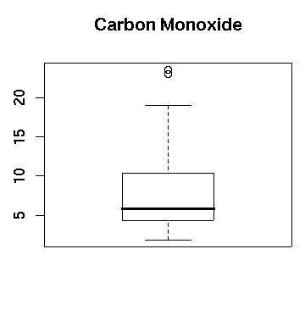
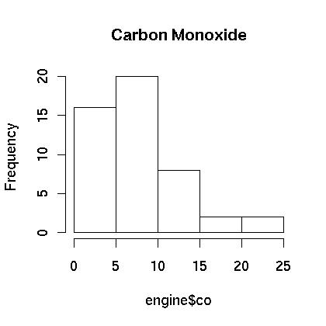
Data Transformations
Example from Today’s Lab….
Figure 1. Boxplot of the Carbon Monoxide Data.
Figure 2. Histogram of the Carbon Monoxide Data.

Slide 16
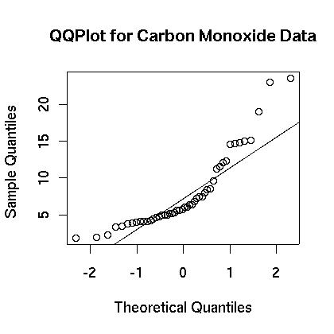
A new kind of plot….
Figure 3. Normal QQPlot of Carbon Monoxide Data.

Slide 17
A new kind of plot….
In statistics, a Q-Q plot^{[1]} ("Q" stands for quantile) is a probability plot, which is a graphical method for comparing two probability distributions by plotting their quantiles against each other. First, the set of intervals for the quantiles are chosen. A point (x,y) on the plot corresponds to one of the quantiles of the second distribution (y-coordinate) plotted against the same quantile of the first distribution (x-coordinate). Thus the line is a parametric curve with the parameter which is the (number of the) interval for the quantile.

Slide 18
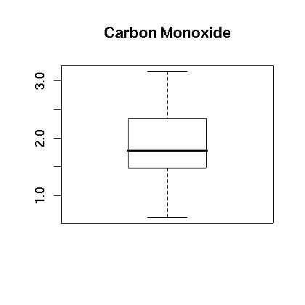
What if I transform the data?
Replace each value with its natural log…
Figure 4. Boxplot of the Logarithm of the Carbon Monoxide Data.

Slide 19
Compare the transformed w/ original
Figure 4. Boxplot of the Logarithm of the Carbon Monoxide Data.
Figure 1. Boxplot of the Carbon Monoxide Data.

Slide 20
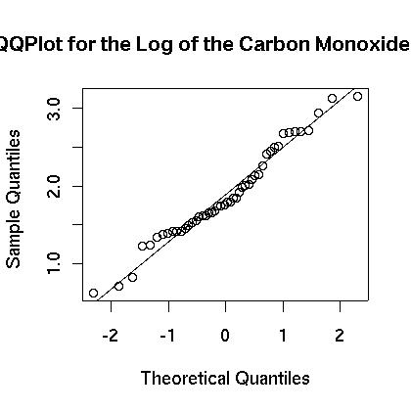
Compare the transformed w/ original
Figure 6. Normal QQ Plot of the Logarithm
of the Carbon Monoxide Data.
Figure 3. Normal QQPlot of Carbon Monoxide Data.

Slide 21
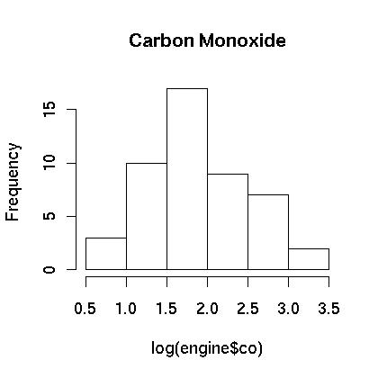
Compare the transformed w/ original
Figure 5. Histogram of the Logarithm
of the Carbon Monoxide Data.
Figure 2. Histogram of the Carbon Monoxide Data.

Slide 22
What else to know about transformations?
Why do they work?
How do I report them? Transform the result back … the inverse transform….
What transformations can I use?
  natural logs of one or both “sides”
  square root
  reciprocal
  etc.

Slide 23
Time check….
Time to preview today’s lab?
Time to preview R?

Slide 24
EML (Ecological Metadata Language): Multi-functional
To define a common structure that all ecologists can use to document ecological data so that other ecologists can correctly interpret the data
To provide structure so that software applications can be developed (written in XML – what’s that?)

Slide 25
EML Best Practices
Metadata Completeness Level
Identification – minimum content for data discovery
  Title, creator, contact, publisher, pub date, keywords, abstract, distribution URL
Discovery – supports targeted searches
  Geographic, taxonomic, and temporal coverages
Evaluation – allows end-user evaluation
  Project, methods, entities, attributes, intellectual rights
Access – supports computer-assisted data retrieval
  Physical access descriptions, access restrictions
  Integration – supports computer-aided data integration
  Attributes, units, measurement scale, constraints, QA/QC
Notes:
Each level adds more elements from the EML schema to provide a more comprehensive description of the data resources documented by the metadata, and thereby support higher functionality.

Slide 26
Metadata Elements
Study description
  General information: data set title, abstract, theme keywords
  Personnel: lead investigator, other researchers, contact information
  Method descriptions: field, lab, analytical
  Study site locations: description, coordinate information
  Taxonomic classification for species
Database description
  Individual entity (table) titles and descriptions
  Attribute (column) definitions and type
    Numerical attributes: units of measurement, data range
    Categorical attributes: enumerated domain of all possible values with definitions
Notes:
Study description metadata cover the first 3 levels of EML Completeness.
Data description addresses access and integration for complete level 5 metadata.

Slide 27
Andrews LTER Metadata Database
Data Object Tables
Information
Products
Search Object
Tables
Databases
GIS (spatial data)
People
Main
Catalog
Publications
Keywords
Satellite imagery
Species
Related Objects
Analytical Tools
Locations
Images
Notes:
The new metadata database allows for the cataloging of diverse data objects such as databases, publications, documents and images into one central catalog. Associating people, keywords, species names and locations to every catalog item allows for searching and locating information products through simple queries. For example, one could ask for all of the databases or publications related to a given person, or could ask for all databases collected at a given site location. Additionally, data objects can be related to one another. For example, publications could be related to databases allowing a search for all publications citing a particular database.

Slide 28
Metadata: Entities and Attributes
Databases
List of all Databases
Entity
List of all entities (tables)
Attribute
Unit_of_measurement
Global list of all attributes (database-specific)
Common units list
Enum_domain
Place_keyword
Taxonomic_classif
Enumeration of
valid codes
Shared location codes
Shared species codes

Slide 29
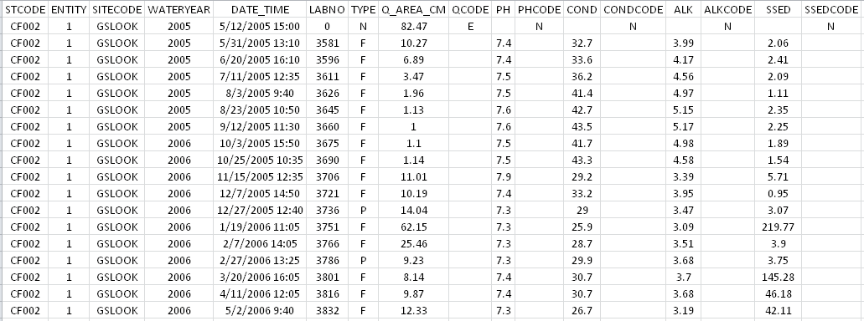
Entities and Attributes: Example
Entity
Entity_Attribute
Attribute
data_restriction_rule
field_order
key_field

Slide 30
Entities and Attributes: Example
Entity
Entity_Attribute
Attribute
data_restriction_rule
field_order
key_field

Slide 31
Entities and Attributes: Example
Entity
Entity_Attribute
Attribute
data_restriction_rule
field_order
key_field

Slide 32
Now, let’s look again at her two examples…

Slide 33
Thursday…..

Slide 34
Metadata Standards in Ecology
Formal metadata specifications
Biological Data Profile
  Standard for National Biological Information Infrastructure (NBII) Metadata clearinghouse (terminated 2012)
  Extends the FGDC spatial standard with taxonomic information
  EML (Ecological Metadata Language) http://knb.ecoinformatics.org/software/eml/
  Standard for LTER/Knowledge Network for Biocomplexity (KNB)
    Provides syntax and content standard
  LTER “best practices” document
    Provides guidance for consistent description of data objects
  LTER Network Information System (LTER Data Catalog)
DataONE – NSF project goals
  Federate access to ecological data (e.g., LTER, KNB, NBII)
  Allow interoperability across other federations (e.g., GEOSS)
Notes:
NBII – 1994
FGDC - Federal Geographic Data Committee - 1990
DataONE - distributed framework and sustainable cyberinfrastructure that meets the needs of science and society for open, persistent, robust, and secure access to well-described and easily discovered Earth observational data

